Slide 1
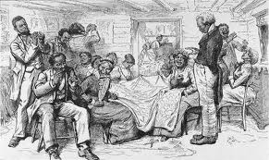
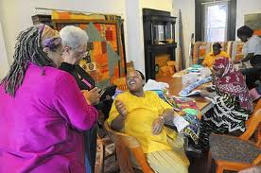
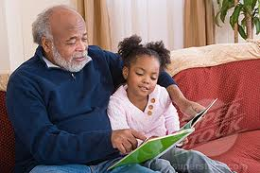

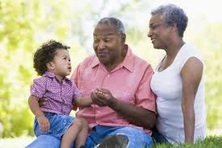
Tradition:
Improvisational heritage
of political culture & consciousness
Lecture #4: Abdul Alkalimat, University of Illinois

Slide 2
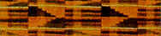
Lecture 1: IDEOLOGY
The ideological framework
Identity
Analysis
Commitment
Program
Action

Slide 3
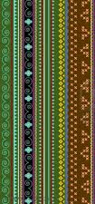
Lecture 2: Methodology
The D-7 Method
D1: Definition
D2: Data
D3: Digitization
D4: Discovery
D5: Design
D6: Dissemination
D7: Difference

Slide 4

Lecture 3: History
Dialectics
Production forces
Production relations
Modes of society
Social cohesion
Social disruption

Slide 5
Modes of
Social cohesion
Africa
Slavery
Rural
Urban
Information
Modes of
Social disruption
Slave trade
Emancipation
Great migrations
Crisis
The basic difference is trans-generation continuity

Slide 6
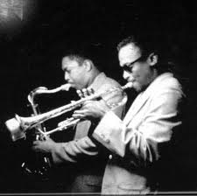
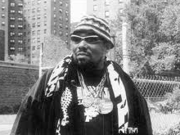
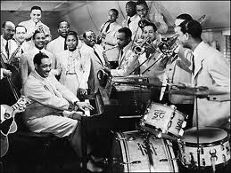
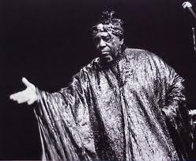
Lecture #4: Tradition
Tradition in the political culture of everyday life
Tradition in ideological frameworks

Slide 7
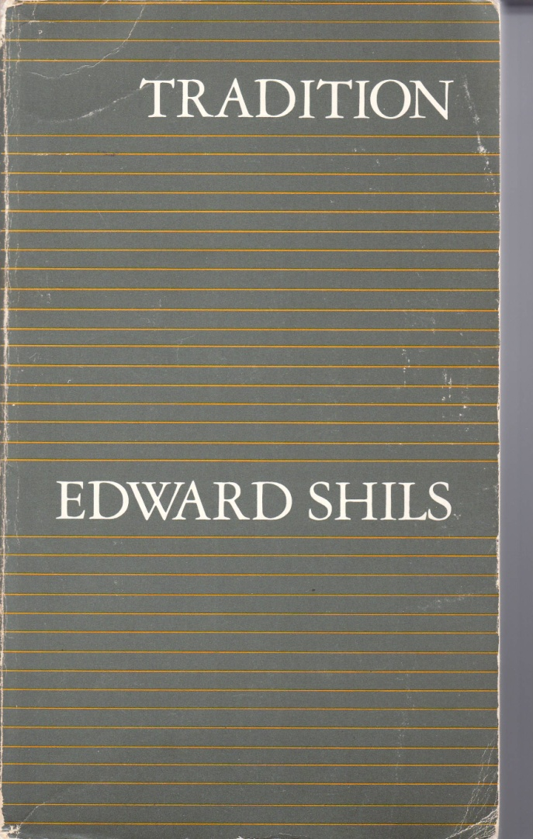
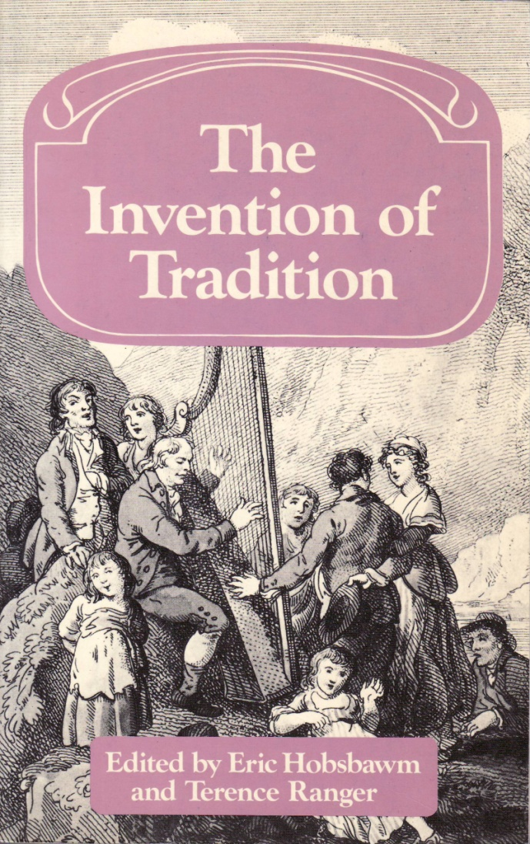
The past does appear in the present and it does
so against the obstacles of death and birth. Those
who bore the things from the past within themselves
die and the past things are left without anyone to
possess them unless the newly born, who did not begin
by possessing them are induced to take them up. The
succession of generations is the moving biological
ground over which the past endures into the present or
Fades away as its possessors change and die. (p 35)
Inventing traditions, it is assumed here, is
essentially a process of formalization and
ritualization, characterized by reference to
the past, if only by imposing repetition. (p 4)

Slide 8

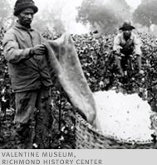
Four notes on a theory of the African American Tradition
Internal forces:
Modes of social cohesion represent
trans-generational continuity
Mode Work experience
Slavery Field work (Plantation)
Rural Field work (tenancy)
Urban Factory wage labor

Slide 9
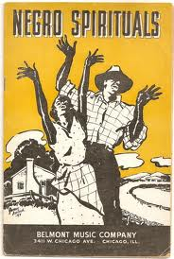
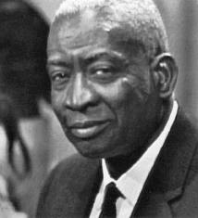
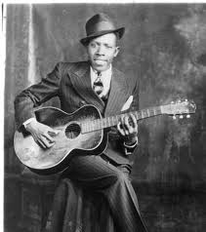
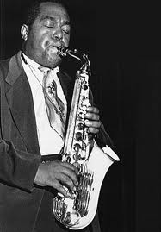
Four notes on a theory of the African American Tradition
Internal forces:
Modes of social disruption necessitate
improvizational transformation
From slave spirituals, to
Gospel of freedom
From rural blues, to
Urban jazz

Slide 10
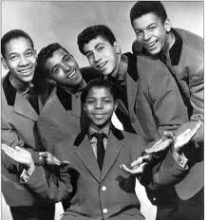
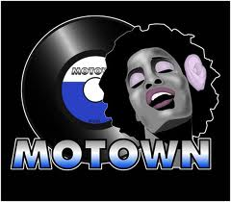
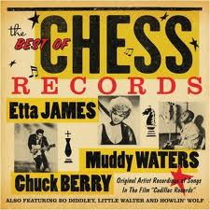
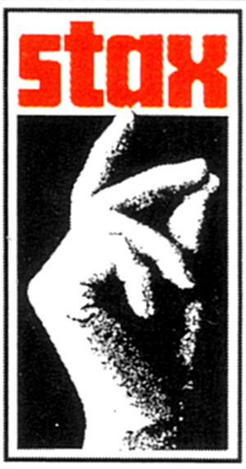
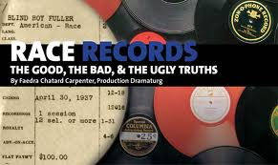

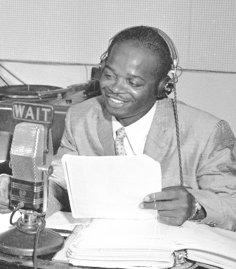
Four notes on a theory of the African American Tradition
External forces :
Commodification and market domination

Slide 11
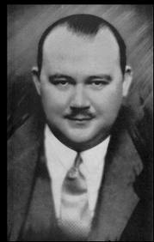
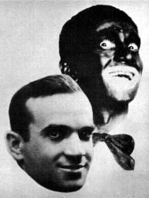
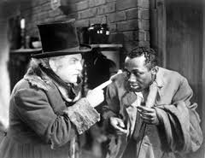
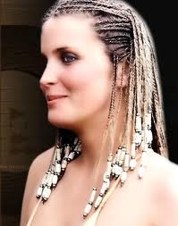
Four notes on a theory of the African American Tradition
External forces:
Racist elimination, emulation, evaluation
Blacks were made to act out stereotypes,
while whites often stole Black creativity!
Everyone believes Southern means white.

Slide 12
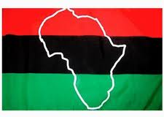
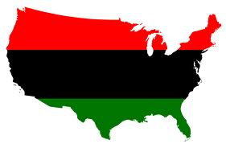
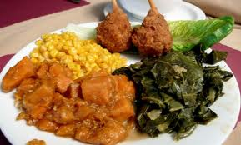
Two fundamental temporal/spatial
references for African American traditions
Back home: to what extent can we find
survivals of African cultural heritage?
Down home: to what extent is the rural
experience of the South continuing today?

Slide 13
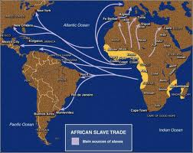
Slave trade: approximately 350
years of captured Africans being
enslaved with their traditions and
the survival
impulse that
required the
affirmation of
humanity at
a basic level.

Slide 14
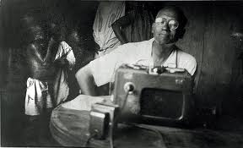
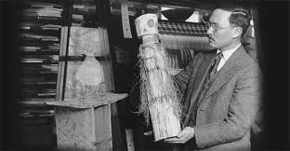

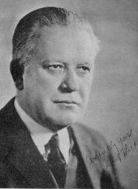
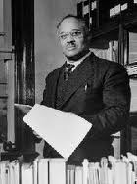
Lorenzo Turner
Melville Herskovits
E Franklin Frazier
Robert Park

Slide 15
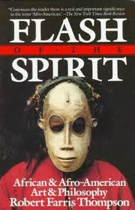

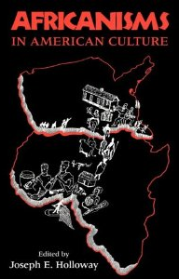
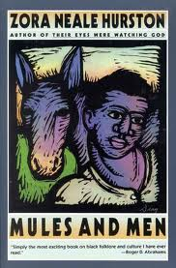
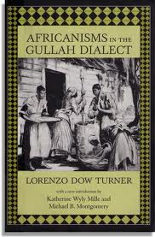

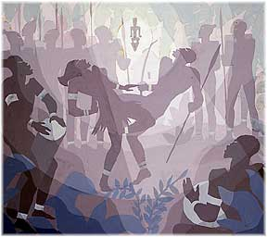

Slide 16
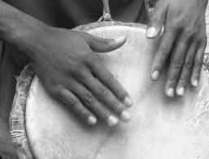
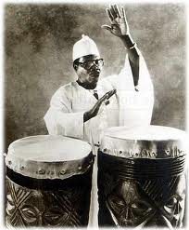
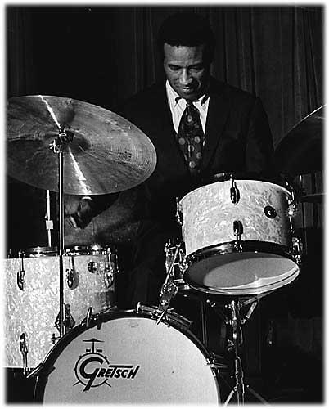
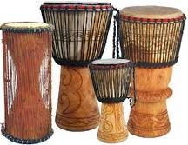
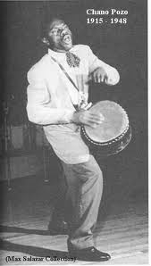
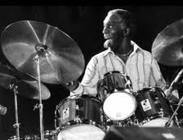
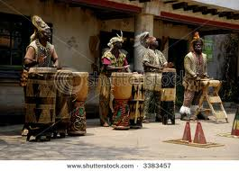

Slide 17
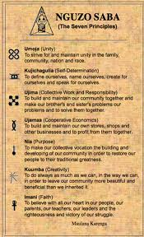
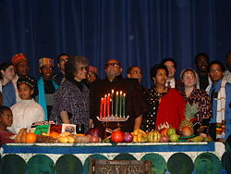
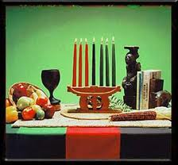


Slide 18





Regional patterns to African American Migration

Slide 19







Black traditions of everyday life:
Food
Names
Speech
Hair
Stories

Slide 20









Slide 21



Food production → distribution → consumption
Pork has been a staple
from Africa til today

Slide 22



Chicken became popular after emancipation:
Sunday frequency named it the “Gospel Bird”
Small and slow during the slave and rural period has
been replaced by large scale factory production and
poor food quality. The crisis has been fought since
emancipation, against fried food and against meat
over vegetables. Survival culture vs factory system.

Slide 23







Urban segregation → “Soul Food” restaurants

Slide 24

We face a crisis
of food deserts in
the inner-city.
Fast food
poisoning is
epidemic.
Cultural traditions
are in ads but
they are lies.
Time now is
for food
rebellion!

Slide 25









Slide 26





2.
3.
1.
1. Traditional African comb
2. Industrial “hot” comb
3. PanAfrican comb
4. Global comb
4.

Slide 27








Slide 28






Slide 29





Slide 30








Slide 31

There is some evidence that direct African
name identity never was completely
eliminated.

Slide 32


From Negro to African American (Names = Nationality)

Slide 33




Malcolm’s names define a pattern
Malcolm Little
Detroit Red
Malcolm X
Malik Shabazz

Slide 34




Many African Americans change names
to reconnect with past identity as protest
and celebration.
From Stokely Carmichael
to Kwame Toure
From LeRoi Jones
to Amiri Baraka
From Arthur Smith
to Molefi Asante
From Gerald McWorter
to Abdul Alkalimat

Slide 35
Bill Cosby created a controversy by rejecting the
improvisational naming practices of many Blacks.
Are you not paying attention, people with their hat on backwards, pants down around the crack. Isn't that a sign of something, or are you waiting for Jesus to pull his pants up (laughter and clapping ). Isn't it a sign of something when she's got her dress all the way up to the crack...and got all kinds of needles and things going through her body. What part of Africa did this come from? (laughter). We are not Africans. Those people are not Africans, they don't know a damned thing about Africa. With names like Shaniqua, Shaligua, Mohammed and all that crap and all of them are in jail. (2004)

Slide 36








Slide 37

Lorenzo Turner (1890 – 1972)

Slide 38
Theories of language change
There are two main hypotheses about the origin of AAVE. One is the dialect hypothesis and the other is the creole hypothesis. The dialect hypothesis is the belief that African slaves, upon arriving in the United States, picked up English very slowly and learned it incorrectly, and that these mistakes have been passed down through generations. In other words, AAVE is just "bad English." The creole hypothesis, however, maintains that modern AAVE is the result of a creole derived from English and various West African Languages. Slaves, who spoke many different West African languages, were often thrown together during their passage to the New World. To be able to communicate in some fashion they developed a pidgin by applying English and some West African vocabulary to the familiar grammar rules of their native tongue. This pidgin was passed on to future generations, and as soon as it became the primary language of it's speakers it is classified as a creole. Over the years AAVE has gone through the process of decreolization and is beginning to sound more like Standard English.
http://bryan.myweb.uga.edu/AAVE/

Slide 39


Critical issues:
Code switching
High school drop out rates
Pop culture
Class polarization
Prison culture spreading
Unemployment rates

Slide 40









Slide 41


Animal stories survive
The slave trade and
were developed
through improvisation.

Slide 42
The Negro Speaks of Rivers (1921)
I’ve known rivers
I’ve known rivers ancient as the world and older than the flow
of human blood inhuman veins.
My soul has grown deep like the rivers.
I bathed in the Euphrates when dawns were young.
I built my hut near the Congo and it lulled me to sleep.
I looked upon the Nile and raised the pyramids above it.
I heard the singing of the Mississippi when Abe Lincoln went
down to New Orleans, and I’ve seen its muddy bosom turn
all golden in the sunset.
I’ve known rivers.
My soul has grown deep like the rivers.
Langston Hughes (19 years old)

Slide 43



Autobiography is the strongest
tradition of story telling.

Slide 44






Traditions of
consciousness
as ideological frameworks
Panafricanism Nationalism
Liberation theology Feminism Socialism

Slide 45









Slide 46



Fundamental dialectic of
African Americans
And Africa
Forced relocation
but memory remains
Degradation of Africa
produces shame
Africa awakens &
decolonizes creating
pride, identity

Slide 47









Three faces of Panafricanism
Back to Africa →
Global struggle →
Unite the continent →
Edward Wilmot Blyden, Marcus Garvey, Martin Delany
Sylvester Williams, W. E. B. Du Bois, A. M. Babu
Kwame Nkrumah, Julius Nyerere, Patrice Lumumba

Slide 48


Organizational History of Panafricanism
Panafrican congresses
1919 Paris
1921 London
1923 London/Lisbon
1927 New York
1945 Manchester
1974 Dar es Salaam
1994 Kampala

Slide 49







Our music connects us to Africa

Slide 50

New migrations make a difference
(2010 Census)

Slide 51
New migrations make a difference
(2010 Census)

Slide 52









Slide 53


Nationalism is a dialectical reality
External – racist forces of segregation
forced isolation on Black people
Internal – unity of common experience
and need for defense to survive
1963

Slide 54






Dogma drives ideological tradition
Elijah Muhamad, Wallace D. Ford, Marcus Garvey
Above: Noble Drew Ali,
Left: Hubert Harrison

Slide 55


From the Black Belt into the cities:
Black power began to be expressed on the
street, at the ballot box and at the cash register

Slide 56









Slide 57



African
religion
survived
in the west
Voodoo
Santeria
Candomble
Liberation theology

Slide 58


Organization history of the Black church
Invisible institution
Institutional church
donated land,
rented store front
bought church
built church

Slide 59



Was Jesus Black?
Does it matter?
Does it matter that
Religion has been
used to oppress?

Slide 60

The Black church has been a site of liberation.
King was an example. But how many Kings?

Slide 61
The church is the major independent
social institution in the Black community.
Where do families gather every week?
Who helps the sick and shut in?
Who develops programs for the youth?
Who feeds the hungry?
Who develops leadership skills?
Where do we sing every week?
Where is the greatest real estate?
Who is the community spokes person?
Where can the community meet in crisis?
Where do we marry? Mourn our dead?

Slide 62









Slide 63

Triple oppression
nationality, class, gender
The black woman is demanding a new set of female definitions and a recognition of herself of a citizen, companion and confidant, not a matriarchal villian or a step stool baby-maker. Role integration advocates the complementary recognition of man and woman, not the competitive recognition of same.
Third World Women’s Alliance 1970

Slide 64





Feminism:
Dynamic Black women
Have always been
ideologically strong
Sojourner Truth
Ida B. Wells, Fannie Lou Hamer, Ruby Doris Robinson

Slide 65





Slide 66






Who will defend
Our little girls?
Where are the
New Role models?
Will the new
Multiculturalism
Provide a strong
Black identity?

Slide 67









Slide 68


Freedom from slavery meant becoming
part of a capitalist society.
But Black people never
got 40 acres and a mule!
Freedom from capitalism
meant workers taking power.
It hasn’t happened yet!
What does
freedom
mean?

Slide 69






Slide 70

Radical Black Tradition
Panafricanism
Nationalism
Black Liberation
Feminism
Socialism

Slide 71

Tradition in everyday life has been torn apart by historical
disruptions but never destroyed. Black people survive
through their appropriation of the past and their constant
creative improvisation. We live because we can make music
in every aspect of our lives – always new/old music
Tradition in ideological frameworks survive through the
protection of dogma as a reference to combat the ever
present problems that reproduce past oppression. The
elders and the books keep us going.

Slide 72

Thank you for watching.
Please send comments to
H-Afro-Am@H-Net.msu.edu

